Slide 1
Gender Prediction Based on Vietnamese Names
1
Phạm Lê Trưởng - 20522090
Trần Phương Thảo - 20521938

Slide 2
Introduction
2
Nowadays, gender prediction is one of the most critical problems in machine learning with various applications for marketing, advertising, ecommerce, security, and human behavior.
Because much work has been done it based on people’s names. In marketing, identifying the exact gender of a customer allows one to propose products to the right audience

Slide 3
Describe
Input
Output
Tào A Tuyết
Lư Hữu Tình
Ma Thị Bích Ngọc
Hồ Thị Thanh Nhàn
Nam
Nam
Nữ
Nữ
3

Slide 4
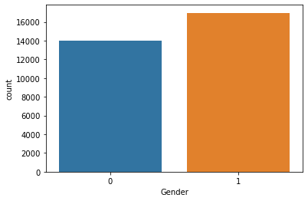
Dataset
A. Dataset Collection
Using UIT-ViNames and over 4,000 data samples collected from ethnic minority schools help to diversify data collection.
The dataset consists of 30,851 Vietnamese names, of which 45,13% are female names and 54,87% are male.
The labels distribution considering the gender (0 for female and 1 for male) is depicted in figure.
“Huy Quoc To et al, “Gender Prediction Based on Vietnamese Names with Machine Learning Techniques”, 2021, https://arxiv.org/ftp/arxiv/papers/2010/2010.10852.pdf
4

Slide 5

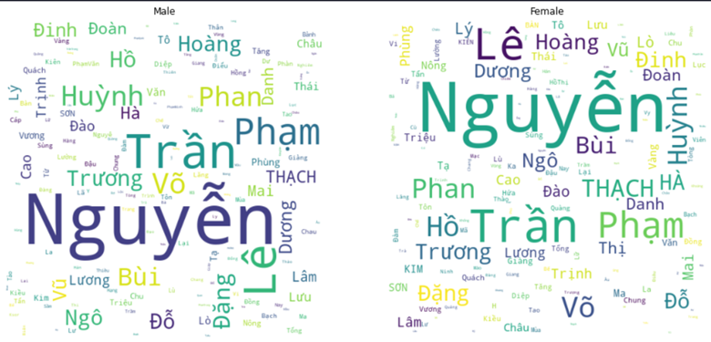
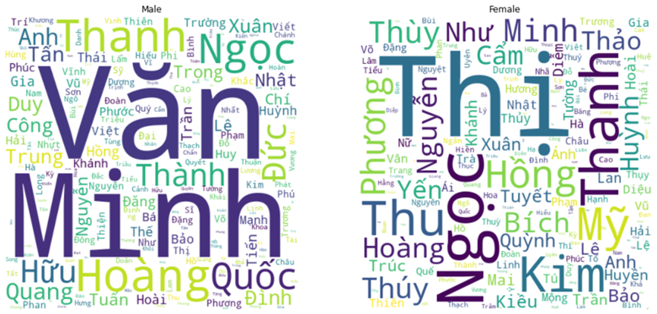
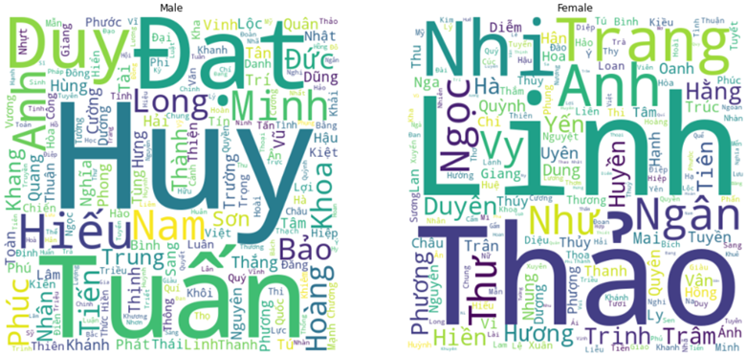
B. Data Analysis
However the surnames of many ethnic people:
Ede ethnic:
Male: Y Ngong Nie Dam (Trai-Tên-Họ-Chi họ)
Female: Hlinh Mlo Duon Du (Gái- Tên-Họ- Chi họ)
Cham ethnic:
Ja (Male): Ja Phôi, Ja Ka
M, Mng (Female): M Ehava, Mng Thang Ôn
Mang, Xa-Dieng,…
The distribution of male and female middle names in Vietnamese.
The distribution of male and female last names in Vietnamese.
The distribution of male and female first names in Vietnamese.
Anh is the one that appears frequently in both Male and Female names.
+ Minh Anh (Minh Anh) is more likely a Male.
+Tú Anh (Tu Anh) has higher percentage to be a Female.
➔ Therefore, we consider last name, middle name and first name in predicting gender
Surnames in both males and females are the same indicating.
➔ No or little impact on gender determination.
Majority of Vietnamese male’s middle names are Minh (Minh) and Văn (Van).
Thị (Thi) is widely applied for naming females.
➔ Middle names are necessary in order to rank up the possibility of detecting genders correctly
5

Slide 6
C. Preprocessing
Removing:
Special characters
Double spacing
Extended characters
Duplicate data
Convert:
The names into lower case
6

Slide 7
Encoding data
01
02
CountVectorizer
TfidfVectorizer
7

Slide 8
Gender Prediction Models
Naïve Bayes
Logistic Regression
SVM
KNN
Decision tree
Random forest
8

Slide 9
Naïve Bayes
Support Vector Machine
Logistic Regression
K-Nearest Neighbors
Decision Tree
Random Forest
Voting Classifier
Naïve Bayes
Support Vector Machine
Logistic Regression
9

Slide 10
Result
Model | CountVectorizer |  |  | TfidfVectorizer
 | Female | Male | Average | Female | Male | Average
Naïve Bayes | 94.07 | 95.12 | 95.49 | 92.87 | 94.17 | 93.52
Support Vector Machine | 94.66 | 95.79 | 95.22 | 94.45 | 95.60 | 95.03
Logistic Regression | 94.54 | 95.67 | 95.11 | 94.25 | 95.46 | 94.85
K-Nearest Neighbors | 91.45 | 93.41 | 92.43 | 89.68 | 91.41 | 90.54
Decision Tree | 91.72 | 93.31 | 92.51 | 91.22 | 92.82 | 92.02
Random Forest | 93.74 | 95.01 | 94.38 | 93.90 | 95.07 | 94.48
Name Components | Naïve Bayes |  |  | Logistic Regression |  |  | Support Vector Machine |  |  | Voting Classifier
 | Female | Male | Average | Female | Male | Average | Female | Male | Average
Family Name (FaN) | 21.68 | 70.07 | 45.88 | 21.68 | 70.07 | 45.88 | 23.76 | 70.00 | 46.88 | 45.88
Middle Name (MN) | 88.75 | 91.13 | 89.94 | 89.68 | 92.45 | 91.07 | 89.53 | 92.29 | 90.91 | 91.05
First Name(FiN) | 85.12 | 88.4 | 86.76 | 85.28 | 88.31 | 86.80 | 85.69 | 87.95 | 86.82 | 86.82
FaN + MN | 88.47 | 90.84 | 89.66 | 89.42 | 92.29 | 90.85 | 89.09 | 92.04 | 90.56 | 90.79
FaN + FiN | 85.04 | 88.03 | 86.54 | 85.30 | 88.36 | 86.83 | 85.06 | 87.74 | 86.40 | 86.61
MN + FiN | 94.17 | 95.22 | 94.70 | 94.57 | 95.69 | 95.13 | 94.58 | 95.68 | 95.13 | 95.31
FaN + MN + Fi | 94.07 | 95.12 | 94.59 | 94.54 | 95.67 | 95.11 | 94.66 | 95.79 | 95.22 | 95.57
Model | Precision | Recall | F1-score
Naïve Bayes | 94.59 | 94.59 | 94.59
Support Vector Machine | 95.49 | 95.04 | 95.22
Logistic Regression | 95.34 | 94.94 | 95.11
K-Nearest Neighbors | 92.89 | 92.17 | 92.43
Decision Tree | 92.61 | 92.44 | 92.51
Random Forest | 94.56 | 94.24 | 94.38
Using the voting classifier to improve the performance of the model, The results show that using the full name gives the best model performance with 95.57%
That measures such as precision, recall, and f1 are higher than the remaining 5 algorithms
Visual results specify that Support Vector Machine produces the best results with the counting vector method and TF-IDF
10

Slide 11
Demo
11

Slide 12
Conclusion and Future work
Conclusion:
Performed on six traditional machine learning techniques.
Used Voting Classifier to improve the model performance for our dataset results → the rate is up to 95%.
Created a simple web local.
Future work:
Collect more data mainly on ethnic names.

Slide 13
Thank you
12

